Slide 1
Web Scrapping Project SALARY.COM
By Steven Ginzberg

Slide 2
The Website
Salary.com provides salary information for free to job seekers, and more in-depth information to paying subscribers
Free information includes job descriptions, salary ranges and categories across many disciplines
All links from “Category” page are javascript calls;
After trying and failing with Beautiful Soup and Scrapy, I settled on Selenium directly clicking on webpages…

Slide 3
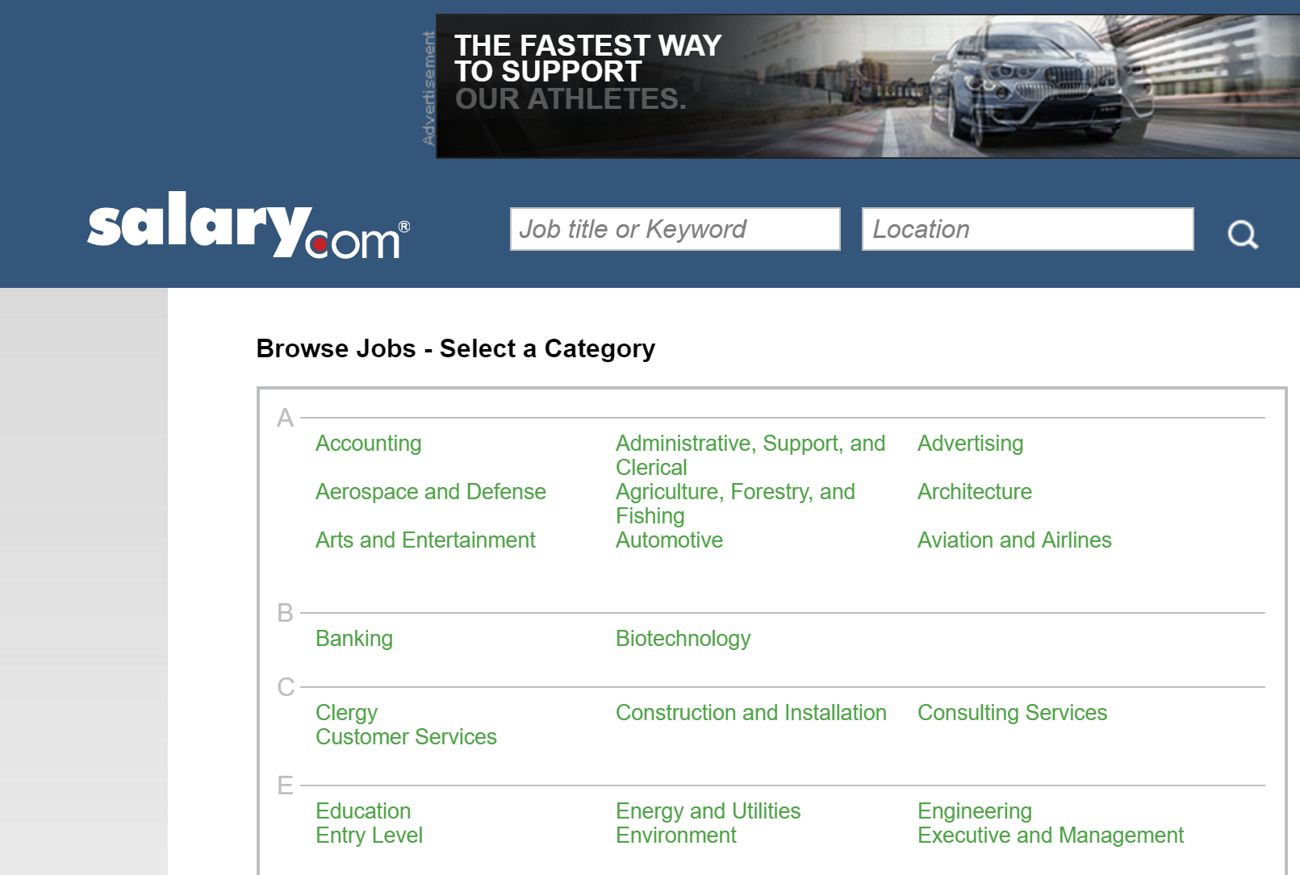
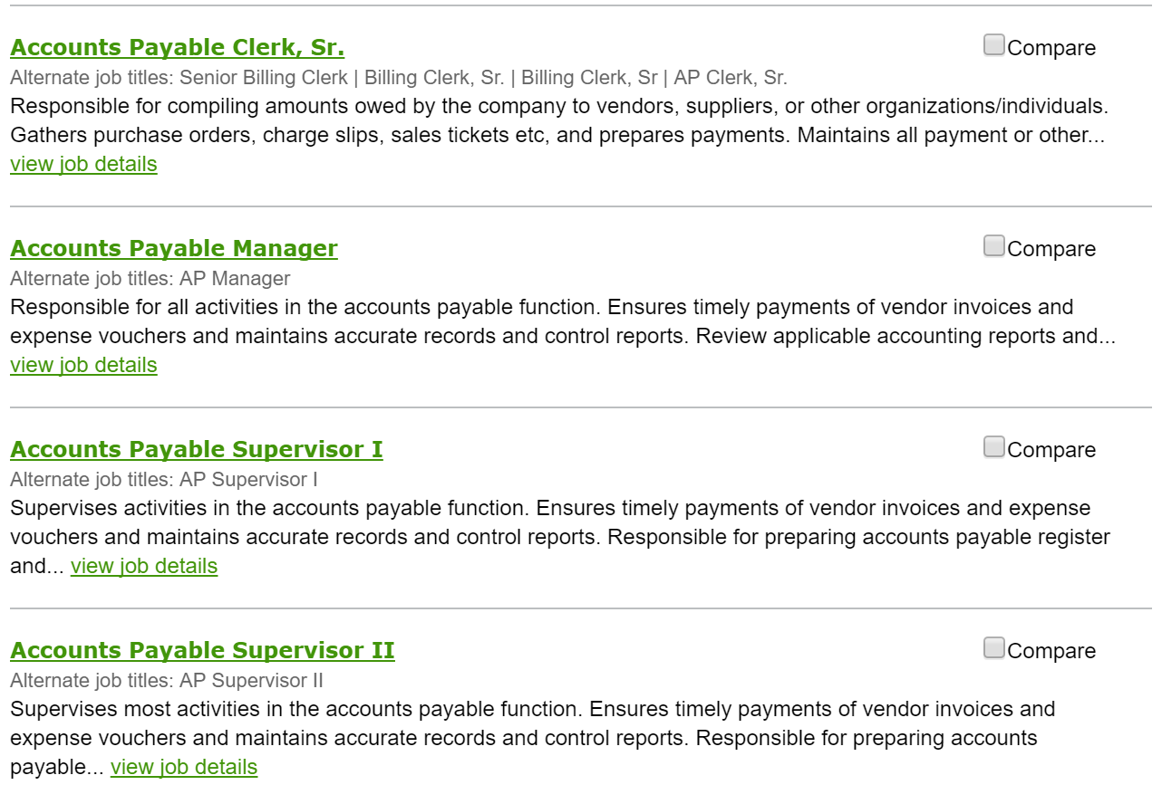
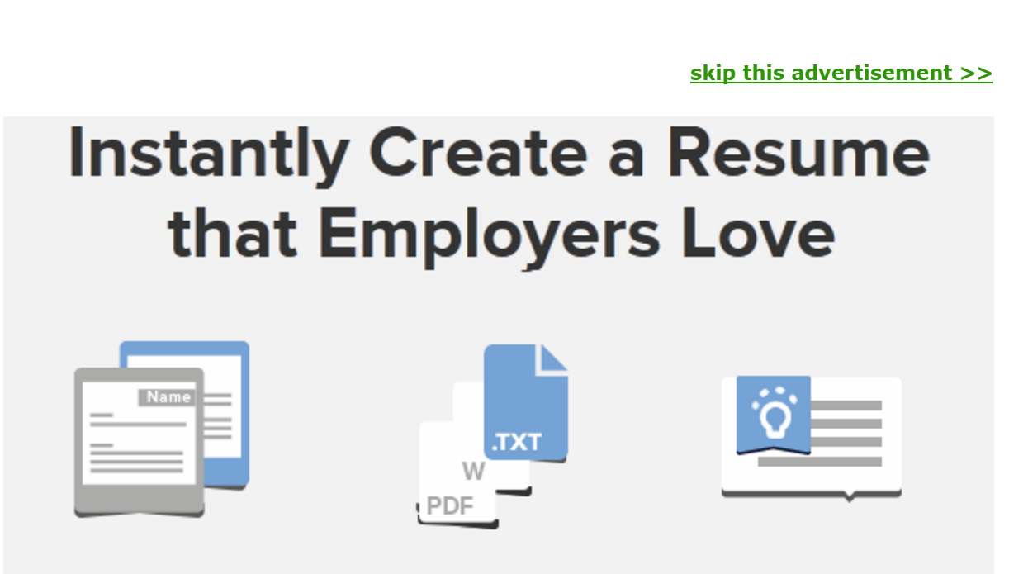
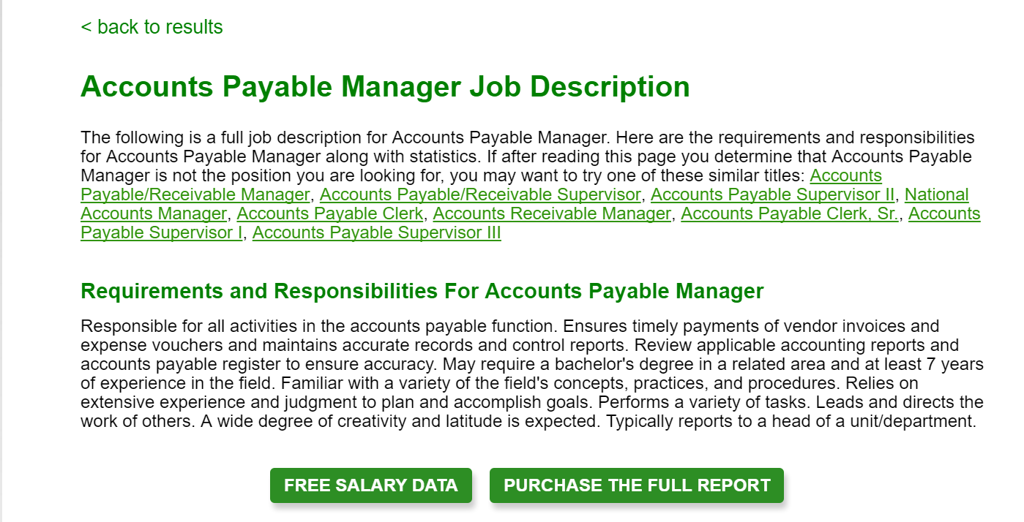
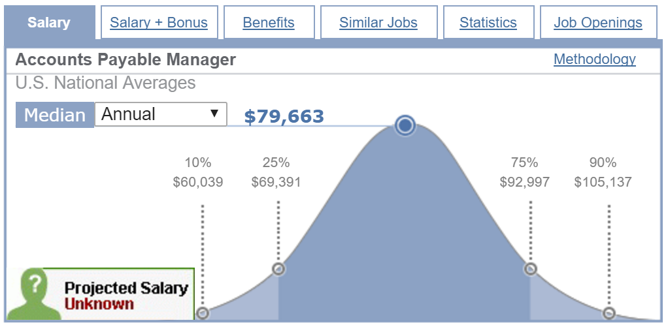
Website Layout

Slide 4
Results
I successfully downloaded summary descriptions for 2,000 job descriptions across 68 categories, each with dozens of pages of listings.
I was unable to drill down further, and still get back to the starting point.

